Slide 1
AI-Based IELTS Scoring System
Team :
Anirudhan K (200801022)
Arvind B (200801031)
Ajay Krishna S (200801012)
Mentor : Dr. L. Bhagyalakshmi

Slide 2
OUTLINE
Abstract
Literature Survey
Block Diagram
Proposed Method
References

Slide 3
Introduction
• IELTS assesses non-native proficiency
• Current scoring is human-based
• AI proposed as alternative using OpenAI.
• Reducing subjectivity in grading
• More accurate and efficient scoring

Slide 4
Objective(s)
To improve the efficiency of scoring process
Maintain high level of accuracy in evaluation process
Reduce human bias in the process of evaluation
Consistent evaluation
To promote transparency in the evaluation process

Slide 5
Problem statement
IELTS (International English Language Testing System) is a standardized exam for the evaluation of English proficiency for non-native speakers. Currently most of the evaluation part is done by humans.
There may be human bias in the evaluation of IELTS exam. Also there are possibilities of human error in the evaluation process.

Slide 6
Proposed system
Pre-trained NLP model
IELTS response feed
GPT 3.5 model
Final Score
Rules and criteria for evaluation

Slide 7
Work flow for writing
Input
Result
Generation of score and remarks
Evaluation based on parameters

Slide 8
Work flow for speaking
Audio Extraction
Transcript Generation
Speaker Segmentation
Evaluation
Result

Slide 9
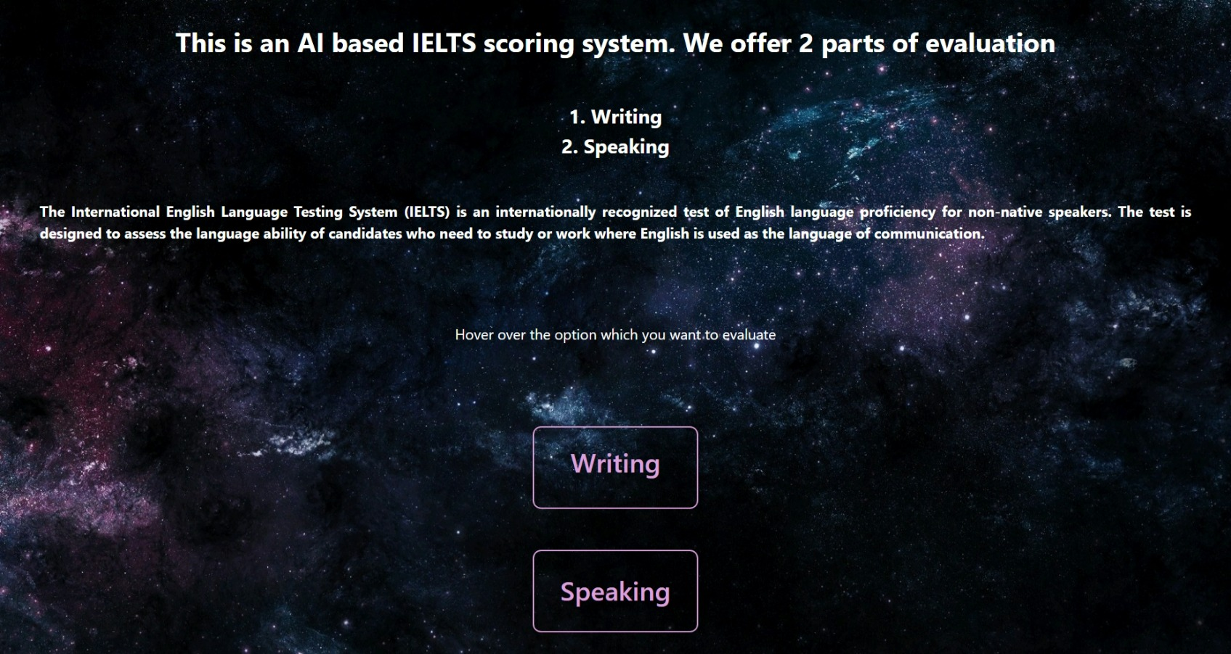
Output (Home page)

Slide 10
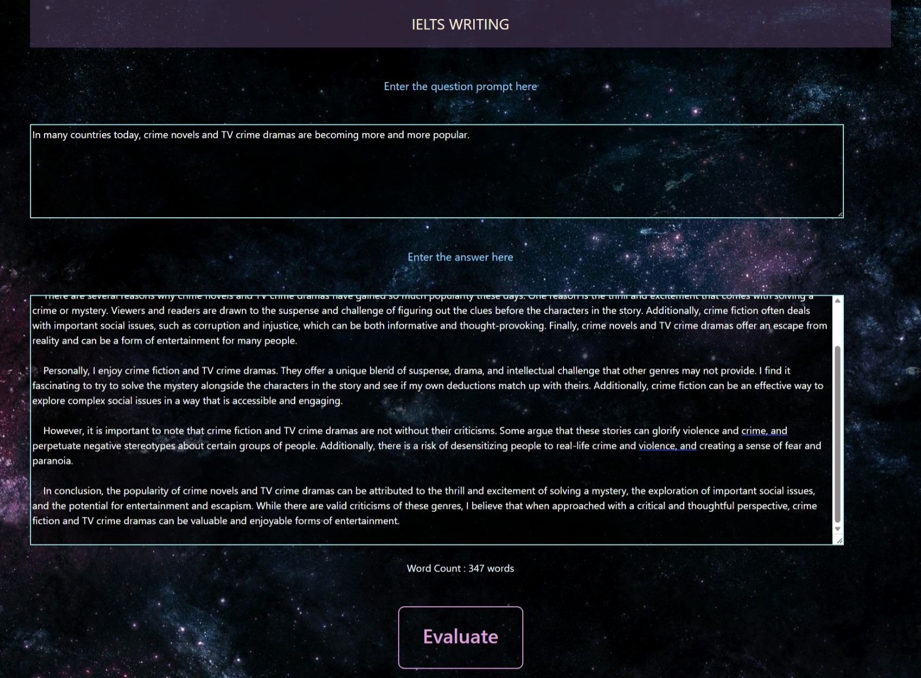
Output (Writing)

Slide 11
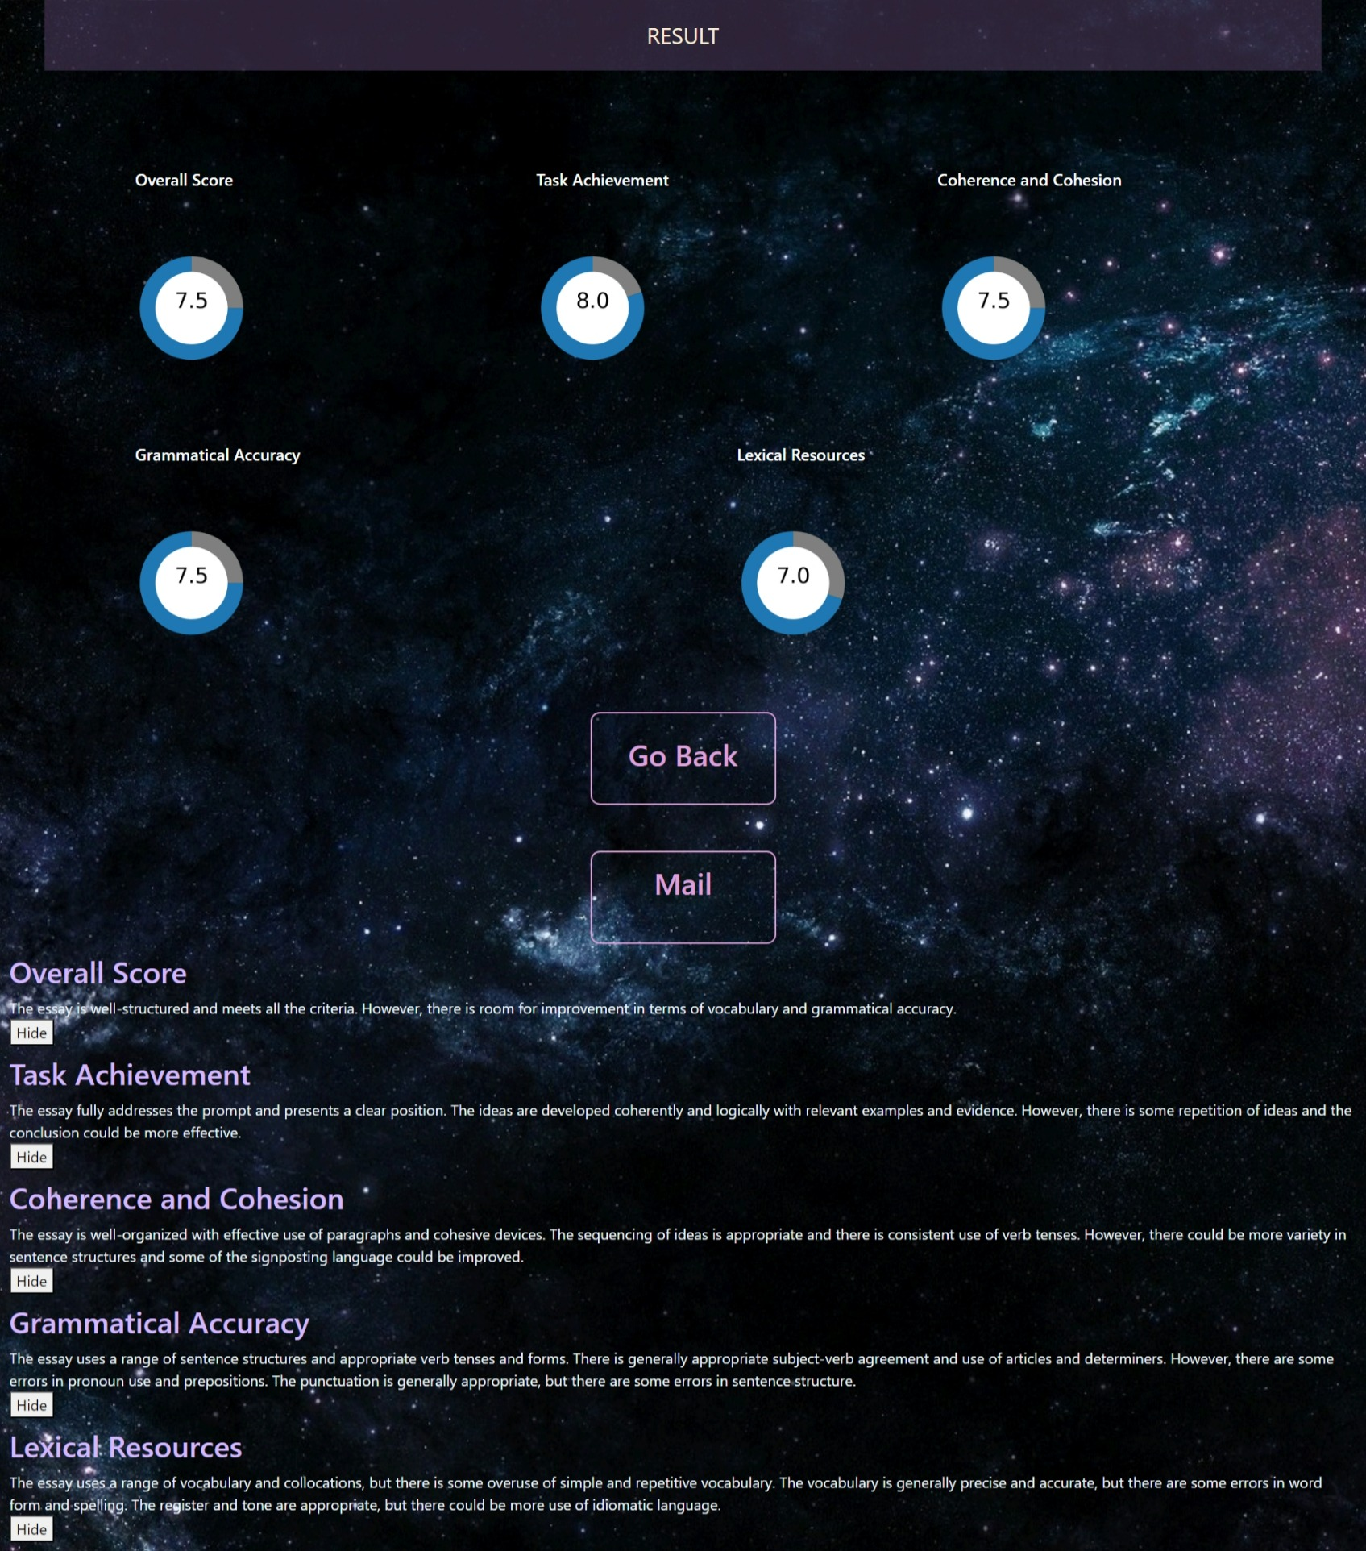
Output (Writing)

Slide 12
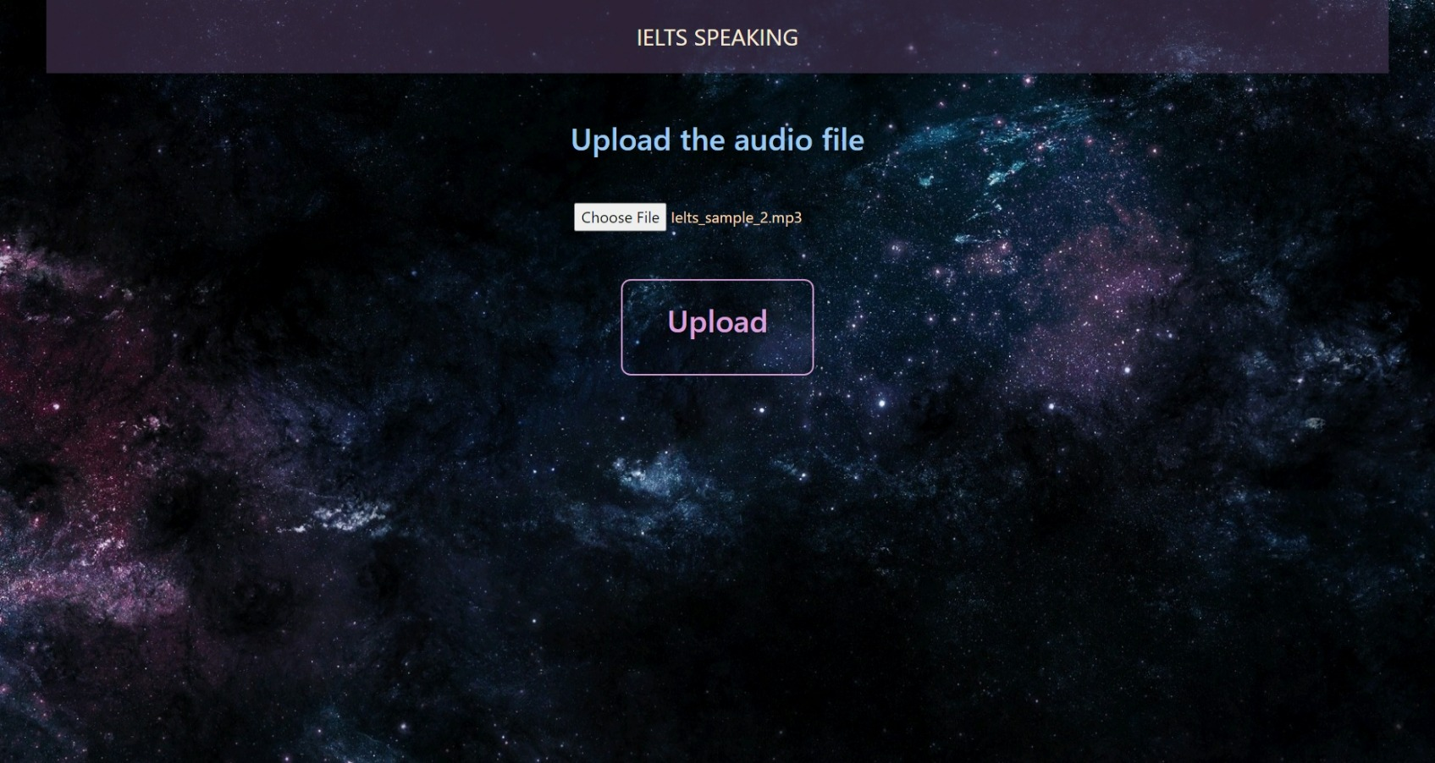
Output (Speaking)

Slide 13
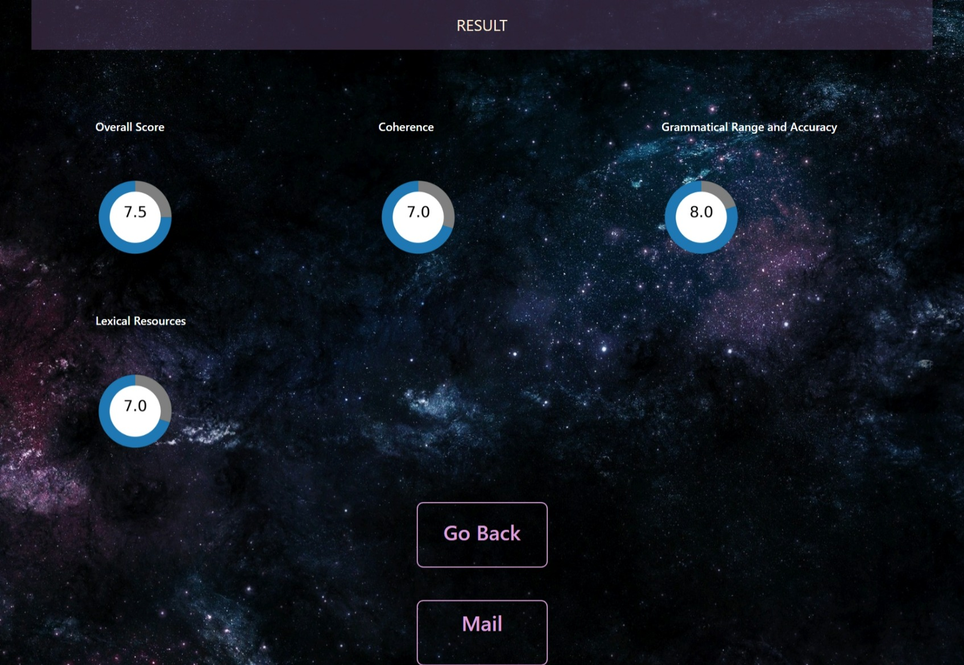
Output (Speaking)

Slide 14
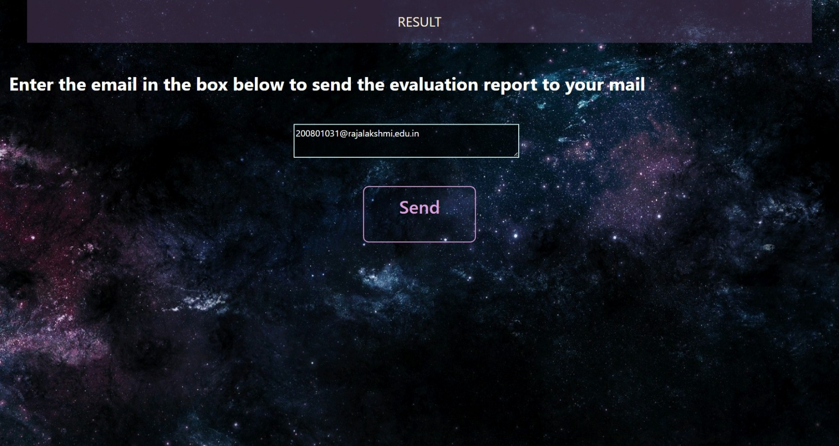
Output (Email the result)

Slide 15
Literature survey
S. No. | Title of the paper | Author name | Journal name & year | Inference
1 | An investigation of the application of GPT-3 in Chinese composition generation | Lu, X., & Ai, H | 2021 | Use of NLP in Chinese composition generation and its empirical effectiveness
2 | Automatic Evaluation of Spoken English Using Artificial Intelligence | C. Xie, X. Huang, and L. Xie | 2021 | AI based spoken English analysis
3 | A review of natural language processing techniques for automated essay grading. | Hedayati, M., & Yazdani, M. | 2019 | NLP provides an efficient, objective, cost-efficient, consistent grading and is capable of providing feedback
4 | Automated Scoring of Non-Native Speech Using Deep Learning | T. Schlippe, S. Vogel, and M. G. Muller | 2019 | Use of Deep Neural Networks (DNN) in the evaluation process
5 | Automated scoring of spoken English tests using speech recognition and natural language processing technologies | Lai, H. C., & Chung, Y. F. | 2018 | Automation improves the accuracy of the evaluation

Slide 16
S. No. | Title of the paper | Author name | Journal name & year | Inference
6 | Automated Evaluation of Oral English Language Proficiency Using Speech Recognition and Machine Learning | P. Aditya and N. R. Jha. | 2018 | Use of AI in oral English evaluation
7 | Effects of Text Length and Question Format on IELTS Reading Test Performance | Binbin Jiang and Tao Huang | 2018 | Impact of text length and question formats in evaluation process
8 | An Investigation of the IELTS Speaking Test: A Test Taker Perspective | Mohammad Reza Anani Sarab and Mohammad Reza Hashemi | 2018 | Perspective of test taskers in IELTS exam
9 | Improving IELTS Listening Skills: A Study of Metacognitive Strategies" by Wang Qi | Wang Qi | 2017 | Relationship between metacognitive strategies and listening performance
10 | Semi-supervised learning for neural machine translation | Taghipour, K., & Ng, H. T | 2016 | It proposed a hybrid approach that combines both human power and AI to produce a more accurate result

Slide 17
References
Dikli, S. (2006). An overview of automated scoring of essays. Journal of Technology, Learning, and Assessment, 5(1), 1-30.
Eguchi, A., & Kulikowski, C. A. (2002). Using machine learning to evaluate student essays. Journal of Technology, Learning, and Assessment, 1(2), 1-42.
Hedayati, M., & Yazdani, M. (2019). A review of natural language processing techniques for automated essay grading. Journal of Information Science, 45(5), 637-658.
Williamson, D. M., & Huotari, P. (2018). Automated writing evaluation in online learning environments: A literature review. Computers & Education, 122, 260-279.

